Slide 1

5 Actionable Traits of a
Successful Listings 123 Host
Data-Based Recommendations

Slide 2
Presentation Outline
Introduction
Project Goal
Explanation of Analysis Performed
Summary of Results
5 Data-Based Recommendations
Individual Recommendations and Supporting Data
Conclusion
Next Steps

Slide 3
Introduction
Goal : Find Traits that make a Successful Listings123 Host
Process : Exploratory Data Analysis (EDA)
Data Wrangling
Results: 5 Traits that make a Successful Host
Data Exploration
Data Exploration
Data Wrangling
Data Visualizations

Slide 4
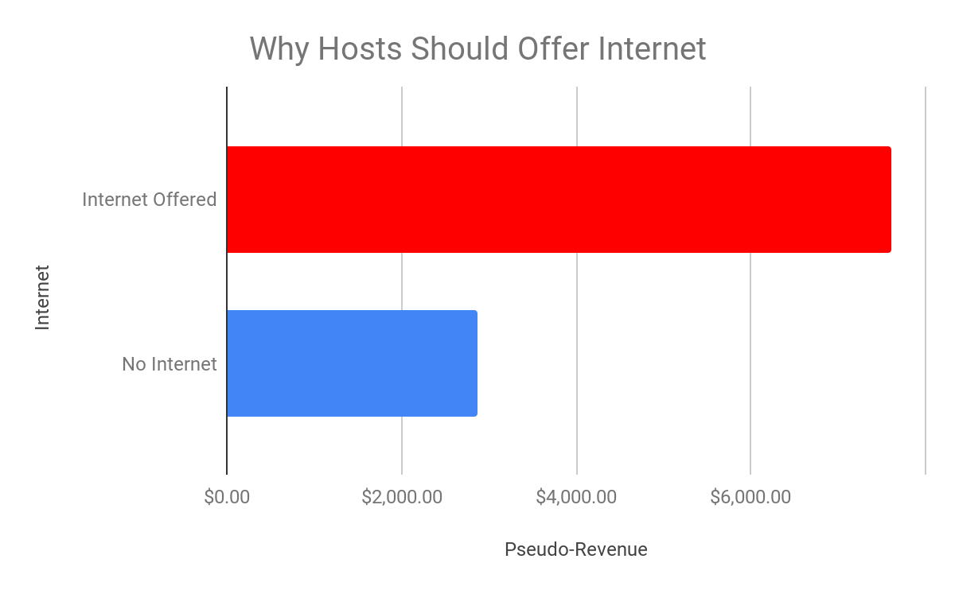
Recommendation 1: 2 Profitable Amenities Hosts
Should Offer
Internet
Hosts should offer Internet
Offering Internet is 165% more profitable
Internet is a crucial part of modern life
98% of our Hosts offer Internet.
We can make that 100%

Slide 5
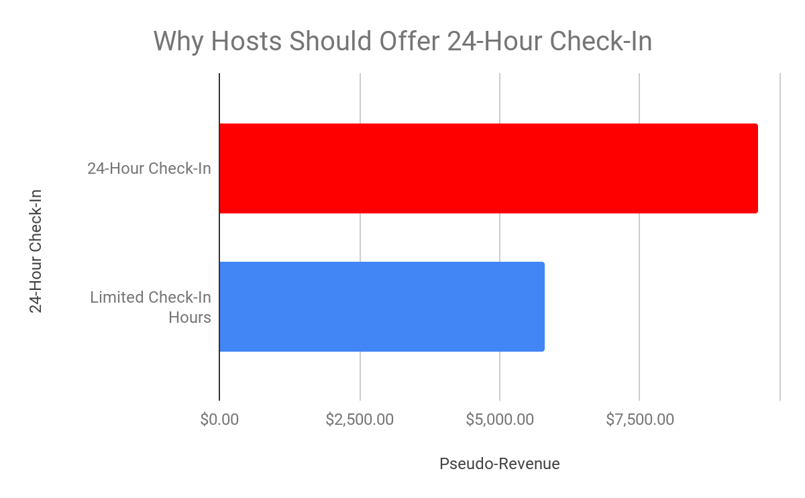
Recommendation 1: 2 Profitable Amenities Hosts
Should Offer (cont.)
24-Hour Check-In
Hosts should offer 24-Hour Check-In
24-Hour Check-In is 65% more profitable
Convenient and Flexible
45% of our Hosts offer 24-Hour Check-In
We can improve that

Slide 6
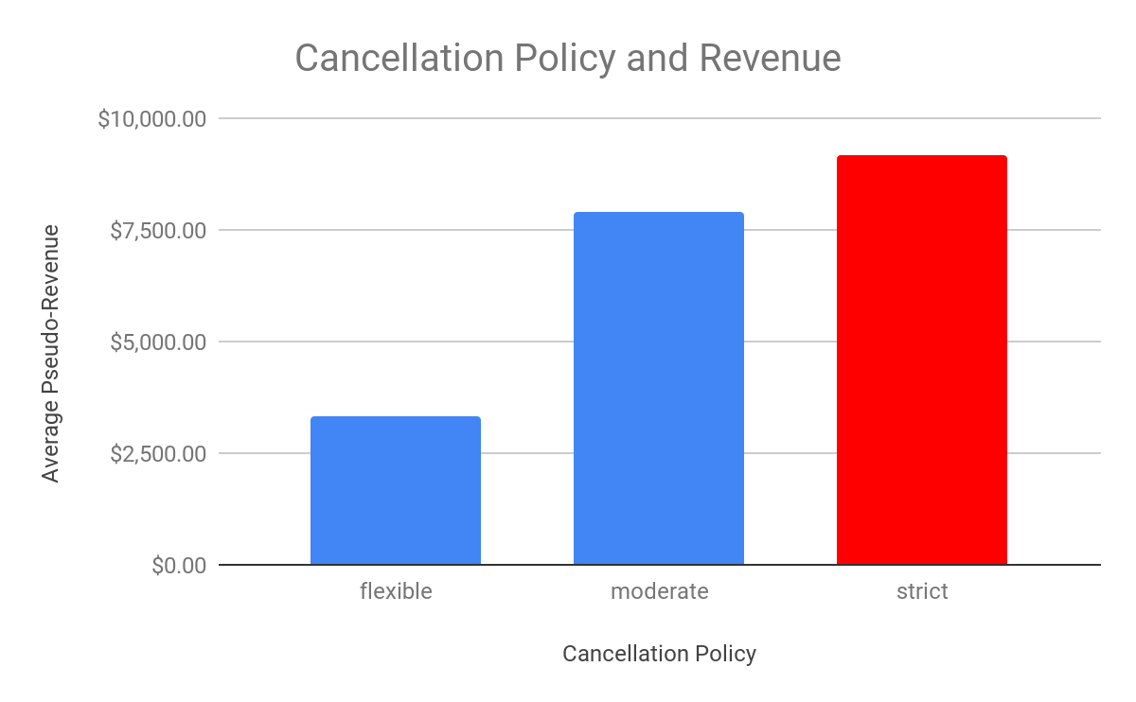
Recommendation 2: Strict Cancellation Policy
Listings with a strict cancellation policy:
Generate 16% more revenue than a moderate policy
Generate 177% more revenue than a flexible policy
A clear cancellation policy helps both guests and hosts
47% of our Hosts have a strict cancellation policy.
Craft a cancellation policy guideline for our hosts

Slide 7
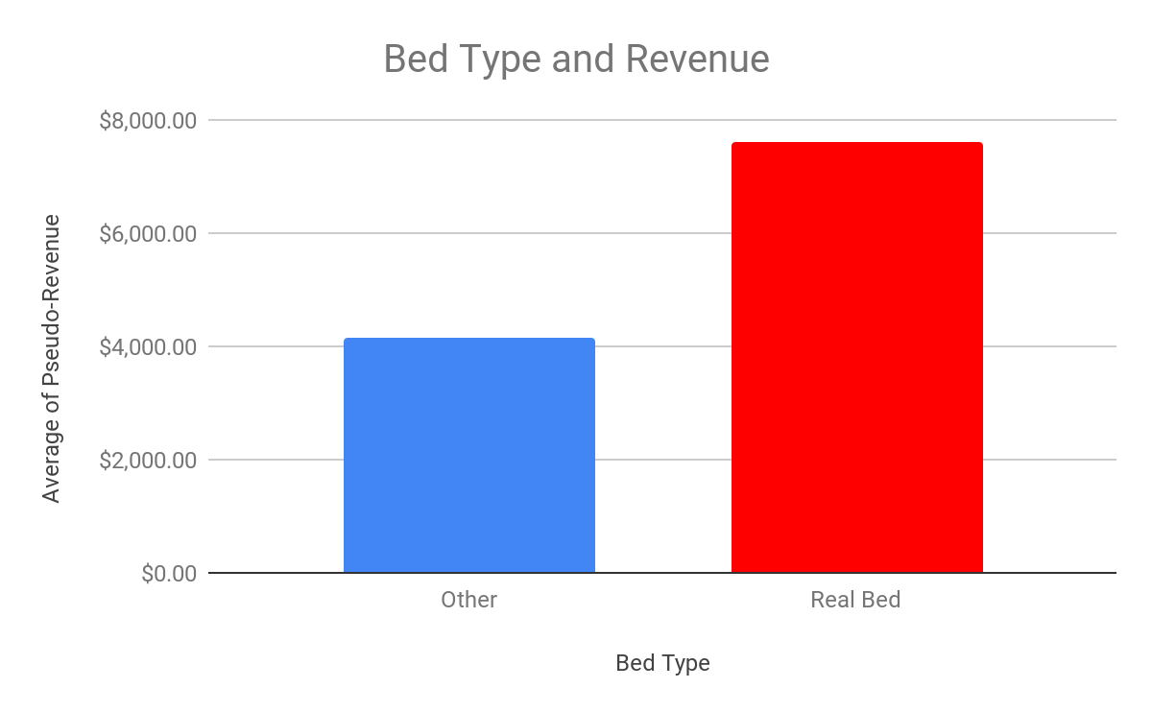
Recommendation 3: Ideal Bed Type - Real Beds
Real beds generate 83% more revenue than other bed types
Guests prefer real beds over other bed types (e.g. couches, air mattresses)
97.5% of our hosts offer real beds at their listings
We can guide the rest toward compliance
Better for our hosts, better for our customers

Slide 8
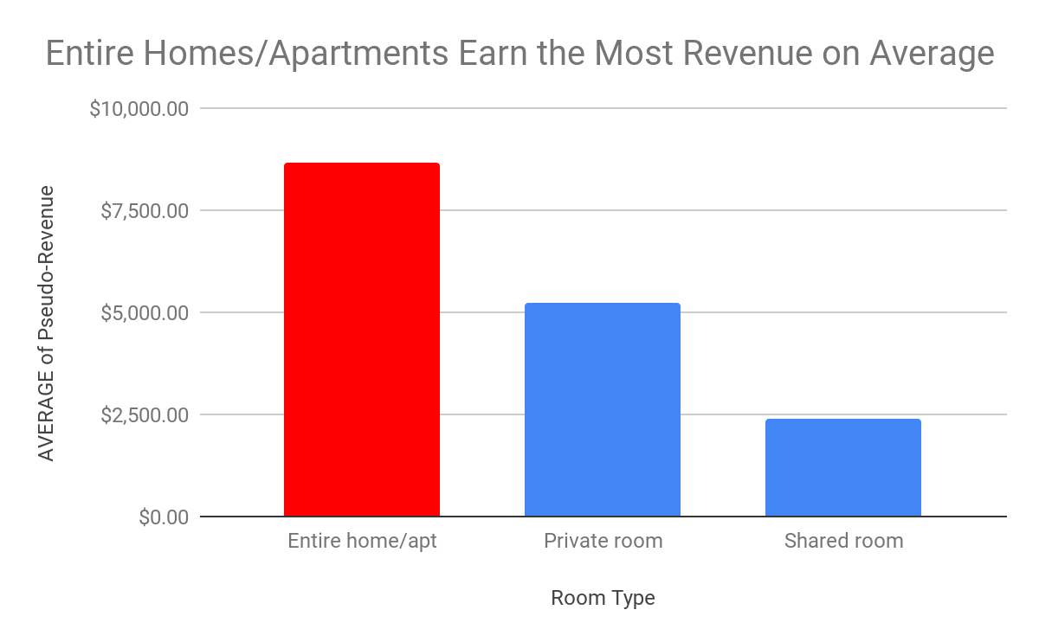
Recommendation 4: Offer Entire Homes/Apartments
Entire Homes/Apartment generate:
65% more revenue than private room listings
258% more revenue than shared room listings
Our guests seem to prefer this listing type
Sets us apart from our competitors (e.g. Airbnb)
67.9% of our Hosts offer Entire Homes/Apartments
Guide our current and potential hosts toward this offering type

Slide 9
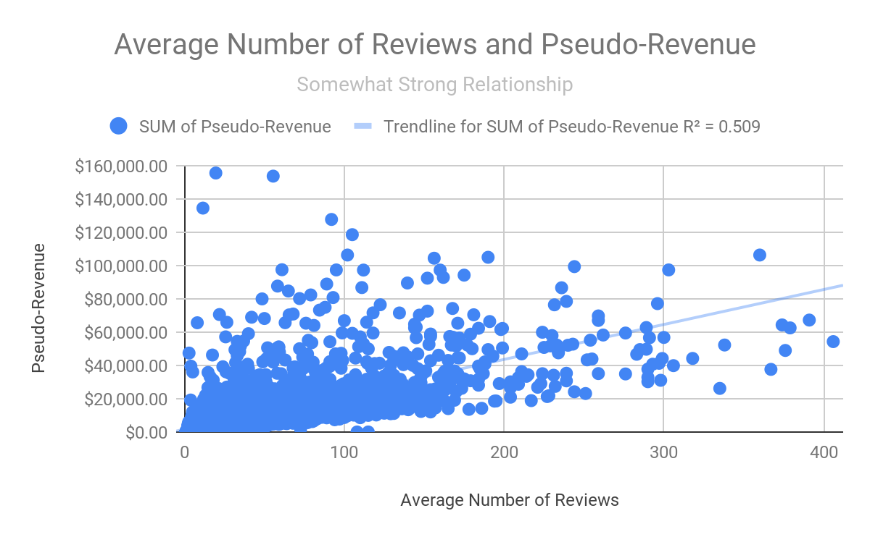
Recommendation 5: Generate More Reviews
The more reviews a listing receives, the more revenue it generates
More reviews help guests feel more comfortable booking a listing
How can we help our hosts generate more positive reviews?
2 factors to focus on

Slide 10
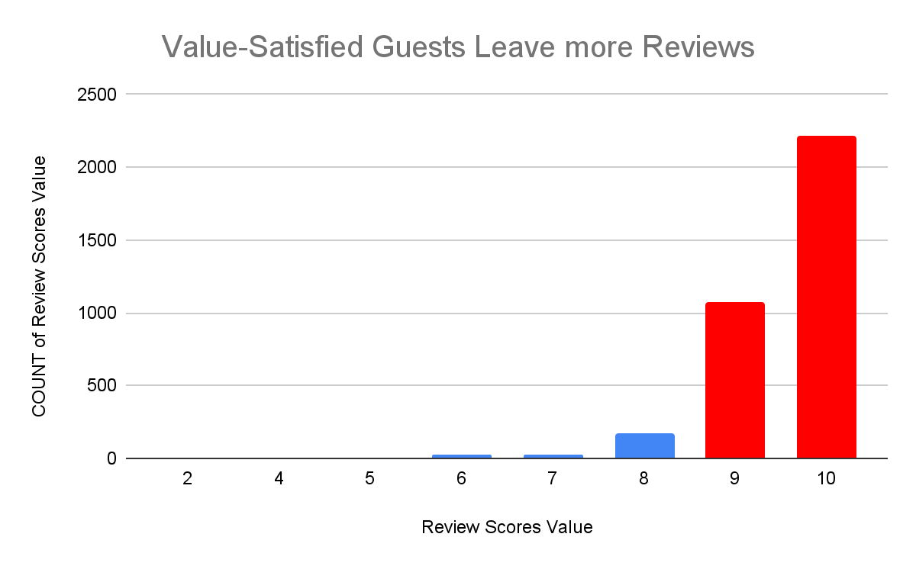
Recommendation 5: Generate More Reviews (cont.)
Focus on Value
Guests that have a 9-10 level of satisfaction with the value of their listing leave 1342% more reviews
Guests want to share about their great experiences
Our Marketing Campaign can help guide our current and potential hosts in offering a value-packed experience

Slide 11
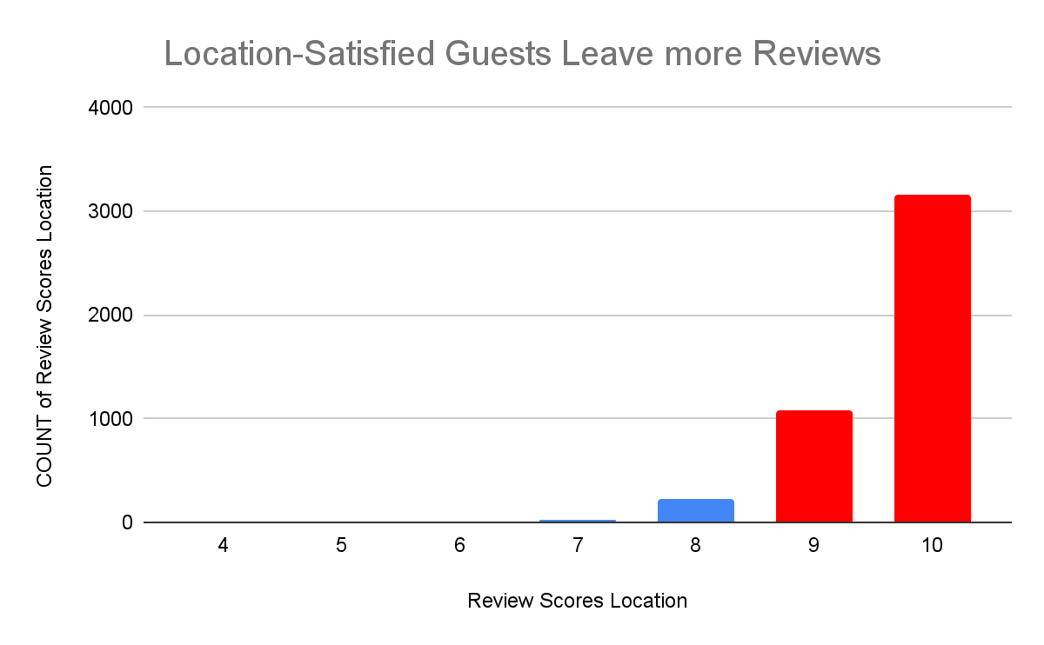
Recommendation 5: Generate More Reviews (cont.)
Focus on Location
Guests that have a 9-10 level of satisfaction with the location of their listing leave 1439% more reviews
Good location: closer to excursions, restaurants, etc.
Our Marketing Campaign can help guide our current and potential hosts in emphasizing the attention-grabbing aspects of their listing’s location

Slide 12
Next Steps
Marketing Campaign
Best possible way to guide our current and potential hosts to offering listings that:
Draw and satisfy more customers
Are more profitable
Differentiate Listings123 offerings from competitors
Help expand Listings123 and continue increasing our revenue
Conclusion - Our Marketing Campaign Needs Your Support
Review of Data-Based Recommendations
Marketing Campaign Importance
Better care for our current hosts; strong draw for potential hosts
Continued growth of Listings123
Making a strong company even stronger

